Slide 1
Lecture 7 3D Modeling and Animation Assoc.Prof.Dr. Hossam Mahmoud Moftah Associate professor – Faculty of computers and artificial intelligence– Beni-Suef University

Slide 2
Chapter 5 Understanding Modeling and
Texturing
Adapted from Andy Beane: 3D animation essentials 2012 by John Wiley & Sons, Inc.,

Slide 3
Lighting vs. Shading
Illumination - the transport of light from a source to a point via direct and indirect paths
Lighting - computing the luminous intensity for a specified 3D point, given a viewpoint
Shading - assigning colors to pixels
Light at a pixel from a light = Ambient + Diffuse + Specular contributions
I_{light} = I_{ambient} + I_{diffuse} + I_{specular}
I_{ambient} = color
Adapted from Andy Beane: 3D animation essentials 2012 by John Wiley & Sons, Inc.,

Slide 4
Shading Techniques
Constant Shading
Calculate one lighting calculation (pick a vertex) per triangle
Color the entire triangle the same color
Gouraud Shading
Calculate three lighting calculations (the vertices) per triangle
Linearly interpolate the colors as you scan convert
Phong Shading
While you scan convert, linearly interpolate the normals.
With the interpolated normal at each pixel, calculate the lighting at each pixel

Slide 5
Lambert’s Cosine Law
Ideally diffuse surfaces obey cosine law.
Often called Lambertian surfaces.
I_{d} = k_{d} I_{light} cos θ = k_{d} I_{light}(N·L).
k_{d} is the diffuse reflectance of the material.
L – direction to light
N-normal
N
I
θ

Slide 6
Phong Lighting Model
I_{s}= k_{s} I_{light}cos^{n}φ = k_{s} I_{light}(V·R)^{n}.
I_{s -} specular
V is the view direction.
R is the specular reflection direction.
L
N
H
V
φ
φ

Slide 7
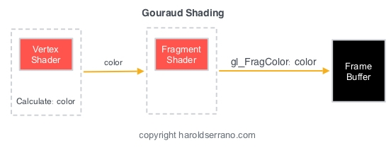
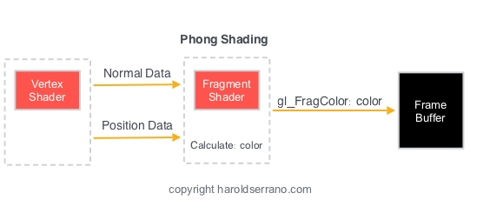
Shading Techniques

Slide 8
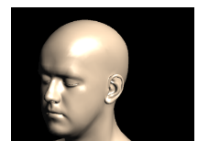
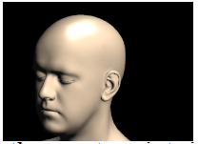
Shading Techniques
Gouraud Shading
Phong Shading

Slide 9
Modeling
Shading of a polygon
Hard-edge polygon vertex normals
In Figure 5.12, The sphere looks very faceted and hard-edged.
Smooth-edge polygon vertex normals
The vertex normals will average the surface normals of two connected faces to achieve this smooth shading.
In Figure 5.13, the polygon wedge has a smooth transition across the top edge;
notice that the arrows representing the vertex normals are averaging the angles of the two faces.
Adapted from Andy Beane: 3D animation essentials 2012 by John Wiley & Sons, Inc.,

Slide 10
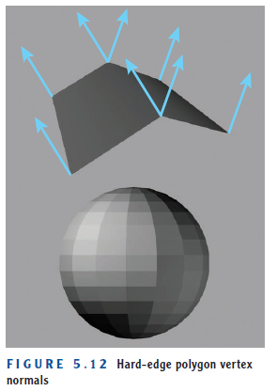
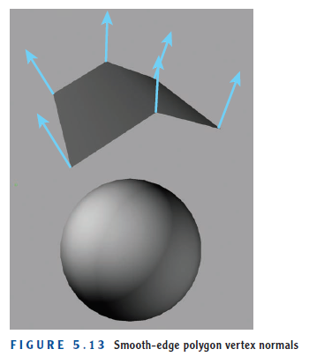
Modeling
Shading of a polygon
Adapted from Andy Beane: 3D animation essentials 2012 by John Wiley & Sons, Inc.,

Slide 11
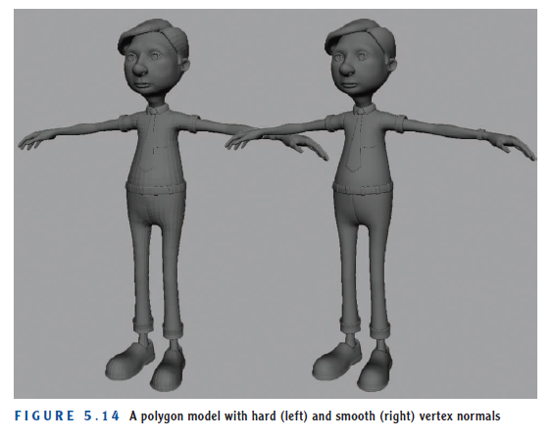
Modeling
Shading of a polygon
Adapted from Andy Beane: 3D animation essentials 2012 by John Wiley & Sons, Inc.,

Slide 12
Modeling
Shading of a polygon
Topology resolution
The density of the polygon mesh, called the topology resolution,
It is an important option in modeling because different industries require different resolutions.
Adapted from Andy Beane: 3D animation essentials 2012 by John Wiley & Sons, Inc.,

Slide 13
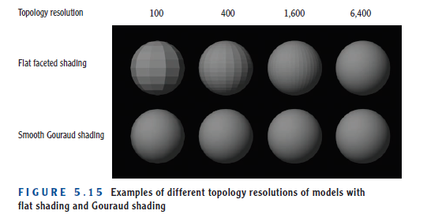
Modeling
Shading of a polygon
Topology resolution
Adapted from Andy Beane: 3D animation essentials 2012 by John Wiley & Sons, Inc.,

Slide 14
Modeling
Shading of a polygon
Topology resolution
Video game vs. Film and television
The video game
The video game industry relies heavily on low-topology resolutions in order to enable real-time interactions during game play.
If all of the objects had overly heavy topology resolutions, the game would not play in real time.
Adapted from Andy Beane: 3D animation essentials 2012 by John Wiley & Sons, Inc.,

Slide 15
Modeling
Shading of a polygon
Topology resolution
Video game vs. Film and television
Film and television
Film and television, on the other hand, can allow for higher topology resolution because a real-time response is not required, and so renders can take up to a day or two per frame.
Adapted from Andy Beane: 3D animation essentials 2012 by John Wiley & Sons, Inc.,

Slide 16
Modeling
Polygon modeling potential problems
Nonplanar Polygon Faces
Laminated Faces
Polygon Bowtie Effect
Two Faces Extruded from the Same Edge
Adapted from Andy Beane: 3D animation essentials 2012 by John Wiley & Sons, Inc.,

Slide 17
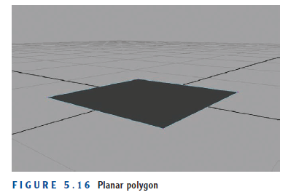
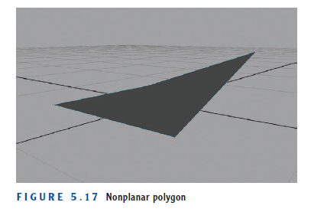
Modeling
Polygon modeling potential problems
Nonplanar Polygon Faces
planar, means the vertices are all on the same plane, as shown in Figure 5.16.
Nonplanar surface, as shown in Figure 5.17, If one of the vertices is not on the same plane
Adapted from Andy Beane: 3D animation essentials 2012 by John Wiley & Sons, Inc.,

Slide 18
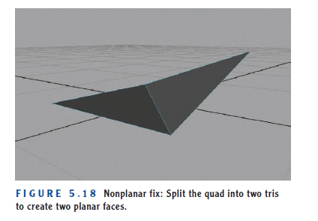
Modeling
Polygon modeling potential problems
Nonplanar Polygon Faces
In addition, smooth shading of a nonplanar face will be inaccurate because of the bend in the shape.
To fix this problem, you can easily split the quad polygon into two planar triangles, or tris, so it will behave and render in an expected fashion, as seen in Figure 5.18.
Adapted from Andy Beane: 3D animation essentials 2012 by John Wiley & Sons, Inc.,

Slide 19
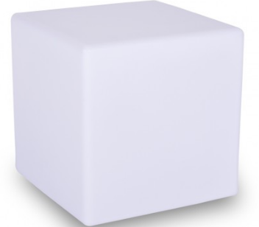
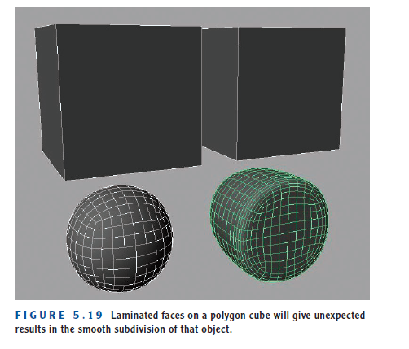
Modeling
Polygon modeling potential problems
Laminated Faces
Laminated faces are polygon faces lying right on top of one another.
As shown in Figure 5.16. this occurs because the front face of the cube on the right is laminated, not allowing the smooth subdivisions to round away the edges.
Adapted from Andy Beane: 3D animation essentials 2012 by John Wiley & Sons, Inc.,

Slide 20
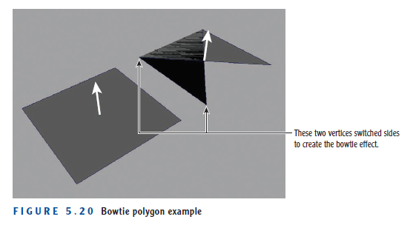
Modeling
Polygon modeling potential problems
Polygon Bowtie Effect
The bowtie effect occurs when a quad or n-gon is twisted but remains on the same plane, which will not allow the software to understand which direction is the front of the normal.
Adapted from Andy Beane: 3D animation essentials 2012 by John Wiley & Sons, Inc.,

Slide 21
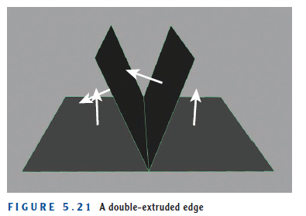
Modeling
Polygon modeling potential problems
Two Faces Extruded from the Same Edge
A similar problem can arise when you extrude two faces from the same edge, as shown in Figure 5.21
Adapted from Andy Beane: 3D animation essentials 2012 by John Wiley & Sons, Inc.,

Slide 22
Modeling
NURBS
NURBS geometry is a mathematical model type that uses smooth curves as guideposts that will span a surface between them.
Ways to create NURBS.
Create a NURBS primitive object
create a series of curves and then loft or layout the surface along the curve
Create a single curve and then revolve it up to 360 degrees to create a surface
Adapted from Andy Beane: 3D animation essentials 2012 by John Wiley & Sons, Inc.,

Slide 23
Modeling
NURBS
Create a NURBS primitive object
The most basic form of NURBS modeling is to create a NURBS primitive object such as a sphere.
The NURBS object has components used to manipulate the object:
control vertices,
hulls,
isoparms.
Adapted from Andy Beane: 3D animation essentials 2012 by John Wiley & Sons, Inc.,

Slide 24
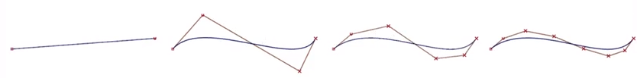
Modeling
NURBS
The NURBS object has components used to manipulate the object:
control vertices,
Control vertices, or CVs, are vertices that do not lie directly on the curve but can be moved to change the shape of the curve, which will then change the shape of the object.
Adapted from Andy Beane: 3D animation essentials 2012 by John Wiley & Sons, Inc.,

Slide 25
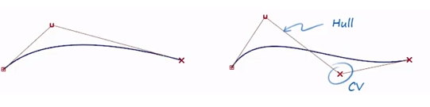
Modeling
NURBS
The NURBS object has components used to manipulate the object:
Hulls,
Hulls are lines of CVs that when selected can be manipulated like a polygon edge.
Hulls
Adapted from Andy Beane: 3D animation essentials 2012 by John Wiley & Sons, Inc.,

Slide 26
Modeling
NURBS
The NURBS object has components used to manipulate the object:
Isoparms,
Isoparms are lines that represent the surface of the NURBS object and can be used to create a new curve along the existing curve to add detail to the surface.
Isoparms
Adapted from Andy Beane: 3D animation essentials 2012 by John Wiley & Sons, Inc.,

Slide 27
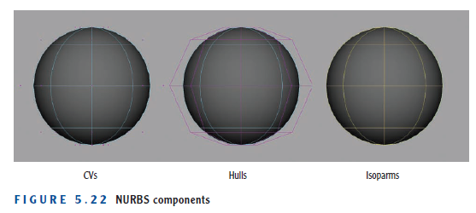
Modeling
NURBS
The NURBS object has components used to manipulate the object:
Adapted from Andy Beane: 3D animation essentials 2012 by John Wiley & Sons, Inc.,

Slide 28
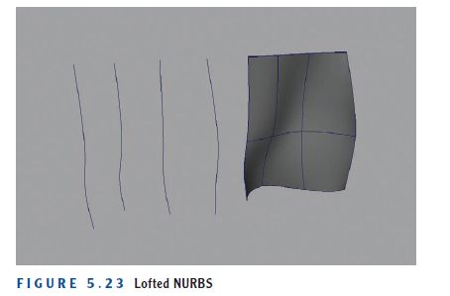
Modeling
NURBS
create a series of curves and then loft or layout the surface along the curve
This method of modeling can create interesting, flat, organic shapes that can be manipulated easily.
Figure 5.23 shows an example: the four curves on the left have been selected, and the surface shown on the right is placed to follow those curves.
curves loft
Adapted from Andy Beane: 3D animation essentials 2012 by John Wiley & Sons, Inc.,

Slide 29
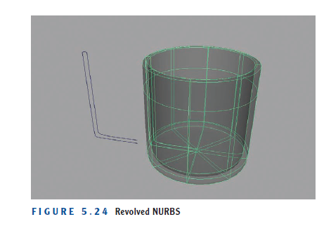
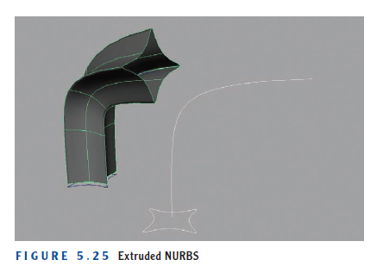
Modeling
NURBS
Create a single curve and then revolve it up to 360 degrees to create a surface,
such as a cup or glass, as shown in Figure 5.24.
You can also extrude surfaces similarly to the way polygons can extrude faces, but along a curve see Figure 5.25.
.
Revolve from image
Revolve
Adapted from Andy Beane: 3D animation essentials 2012 by John Wiley & Sons, Inc.,

Slide 30
The End

